Slide 1
Cloud Services

Slide 2



We don’t ever download & Install Gmail We don’t upgrade Gmail

Slide 3
We don’t ever download & Install Gmail We don’t upgrade Gmail
The story of Cloud-based Services

Slide 4
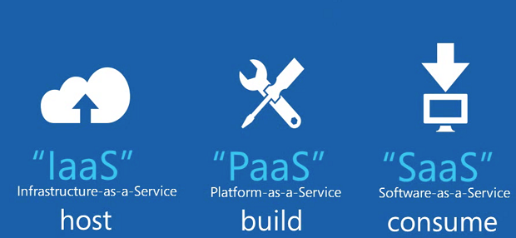

Slide 5
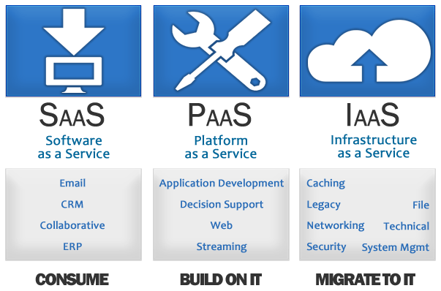

Slide 6
What are the Benefits?

Slide 7
IaaS

Slide 8
Classification of Cloud Computing based on Service Provided
Infrastructure as a service (IaaS)
Offering hardware related services using the principles of cloud computing. These could include storage services (database or disk storage) or virtual servers.

Slide 9
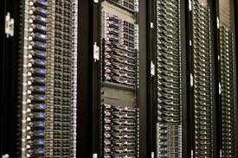
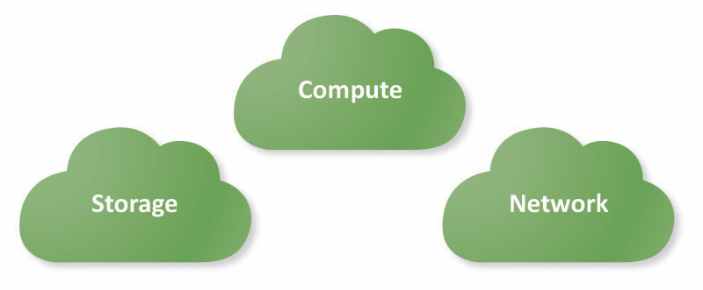
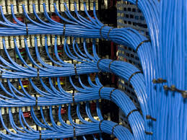
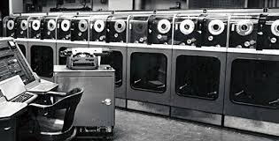

Slide 10
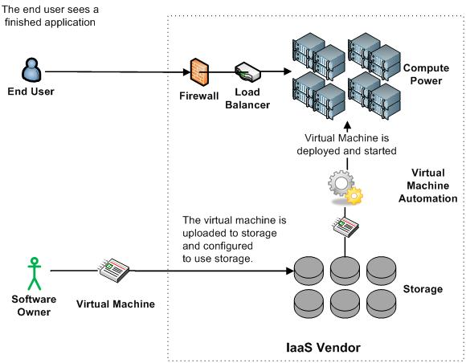
Infrastructure as a Service (IaaS)

Slide 11
PaaS

Slide 12
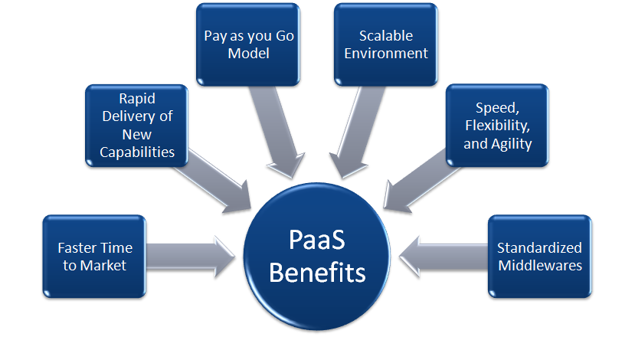

Slide 13
Classification of Cloud Computing based on Service Provided
Platform as a Service (PaaS)
Offering a development platform on the cloud.

Slide 14
Components of PaaS
Operating System
Middleware
Communication
Runtime Enviroment
Databases

Slide 15
SaaS

Slide 16
Classification of Cloud Computing based on Service Provided
Software as a service (SaaS)
Complete software offering on the cloud. Users can access a software application hosted by the cloud vendor on pay-per-use basis. This is a well-established sector.
Salesforce.coms’ offering in the online Customer Relationship Management (CRM) space, Googles gmail and Microsofts hotmail, Google docs.

Slide 17
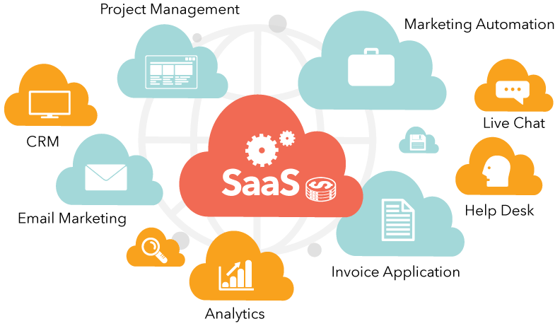

Slide 18
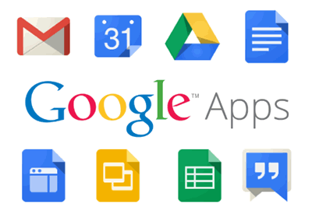

Slide 19
We don’t ever pay for Gmail

Slide 20
Everything as a Service
Utility computing = Infrastructure as a Service (IaaS)
Why buy machines when you can rent cycles?
Examples: Amazon’s EC2, Rackspace
Platform as a Service (PaaS)
Give me nice API and take care of the maintenance, upgrades, …
Example: Google App Engine
Software as a Service (SaaS)
Just run it for me!
Example: Gmail, Salesforce

Slide 21
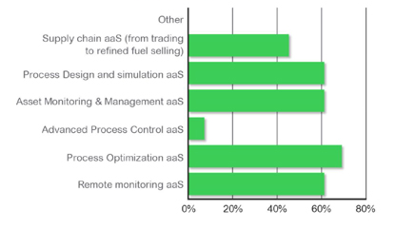
Cloud Services in the O&G Sector
IIoT and the Oil & Gas Value Chain – Part 1: Industry Outlook

Slide 22
Enabling Technology: Virtualization
App
App
App
App
App
App
OS
OS
OS
Operating System
Hypervisor
Hardware
Hardware
Traditional Stack
Virtualized Stack

